Slide 1
Engineering Drawing & Graphics
Engineering Drawing & CAD
Lecture 7
Development of Surfaces
by
Umer Farooq
May, 2019

Slide 2
DEVELOPMENT OF SURFACES
DEFINITION
In sheet metal work or packaging work, full-size patterns of some or all of the faces of an object are required; for example a pattern to which a sheet may be cut so that when rolled, folded, or formed it will make the object. The complete surface laid out in a plane is called the “development” of the surface.
Surfaces about which a thin sheet of flexible material (such as paper or tin) can be wrapped smoothly are said to be “developable”. These include objects made up planes or single curved surfaces only.
Double curved surfaces are nondevelopable, and when patterns are required for their construction, they can be made only be methods that are approximate; but, assisted by the ductility of the material, they give the required form.
All sizes and shapes of faces on a developed surface must be true.

Slide 3
DEVELOPMENT OF A FULL PRISM
The developed surface will have a shape of a rectangle having the length equal to the sum of all sides of a base and the height will be equal to the height of the prism. The folding lines on the developed surface must be shown.

Slide 4
Example 1:
A pentagonal prism of 25 mm each side of base, and 50 mm height rest on the ground on one of its bases. One rectangular face is perpendicular to the V.P. Draw its development.

Slide 5
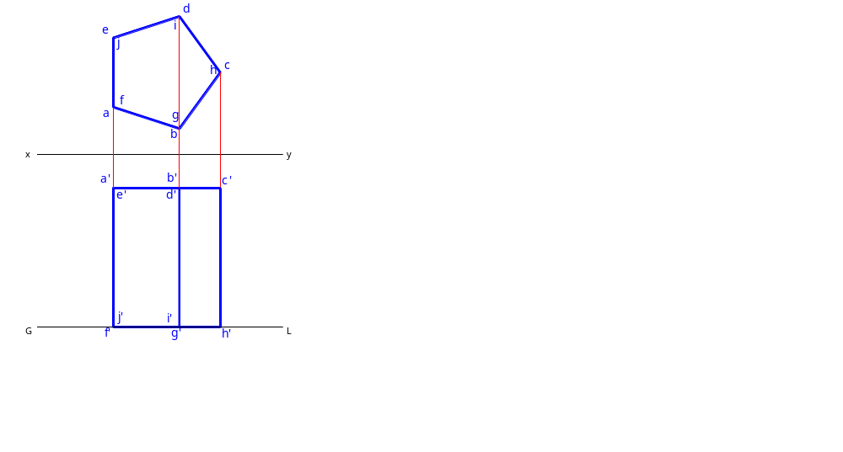
Example 1:
A pentagonal prism of 25 mm each side of base, and 50 mm height rest on the ground on one of its bases. One rectangular face is perpendicular to the V.P. Draw its development.

Slide 6
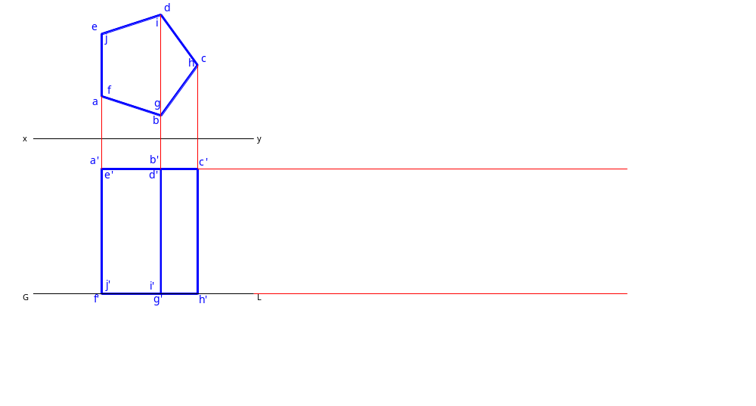
Example 1:
A pentagonal prism of 25 mm each side of base, and 50 mm height rest on the ground on one of its bases. One rectangular face is perpendicular to the V.P. Draw its development.

Slide 7
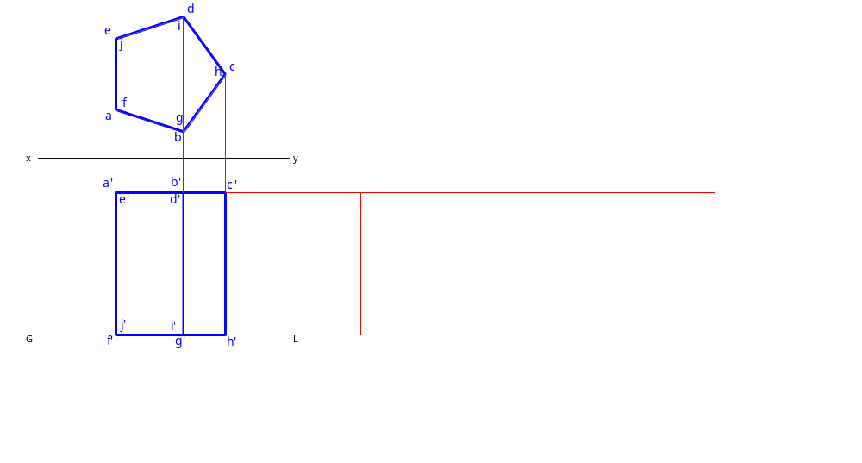
Example 1:
A pentagonal prism of 25 mm each side of base, and 50 mm height rest on the ground on one of its bases. One rectangular face is perpendicular to the V.P. Draw its development.

Slide 8

Example 1:
A pentagonal prism of 25 mm each side of base, and 50 mm height rest on the ground on one of its bases. One rectangular face is perpendicular to the V.P. Draw its development.

Slide 9
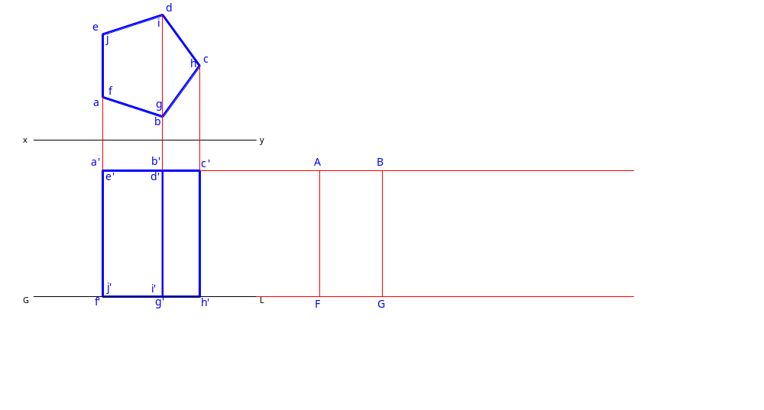
Example 1:
A pentagonal prism of 25 mm each side of base, and 50 mm height rest on the ground on one of its bases. One rectangular face is perpendicular to the V.P. Draw its development.

Slide 10
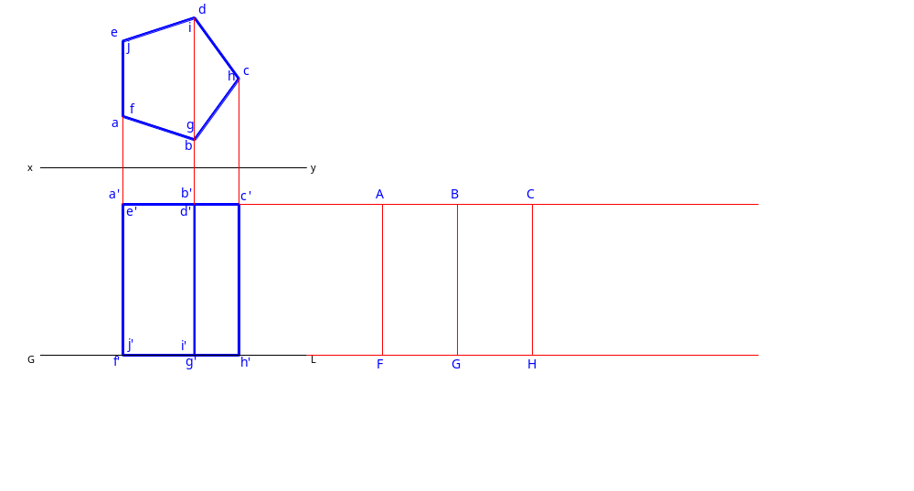
Example 1:
A pentagonal prism of 25 mm each side of base, and 50 mm height rest on the ground on one of its bases. One rectangular face is perpendicular to the V.P. Draw its development.

Slide 11
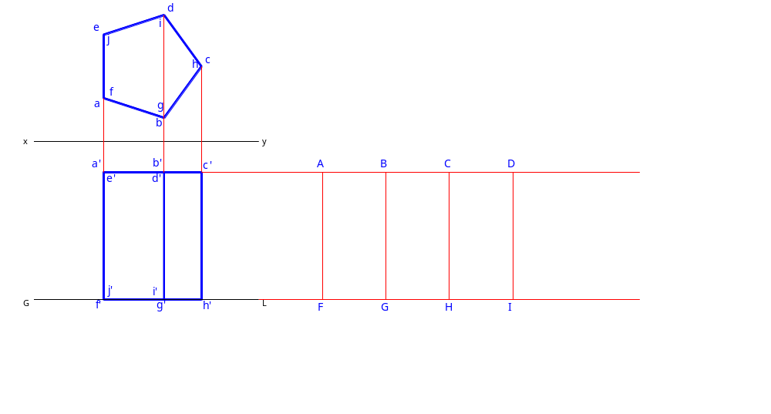
Example 1:
A pentagonal prism of 25 mm each side of base, and 50 mm height rest on the ground on one of its bases. One rectangular face is perpendicular to the V.P. Draw its development.

Slide 12

Example 1:
A pentagonal prism of 25 mm each side of base, and 50 mm height rest on the ground on one of its bases. One rectangular face is perpendicular to the V.P. Draw its development.

Slide 13

Example 1:
A pentagonal prism of 25 mm each side of base, and 50 mm height rest on the ground on one of its bases. One rectangular face is perpendicular to the V.P. Draw its development.

Slide 14
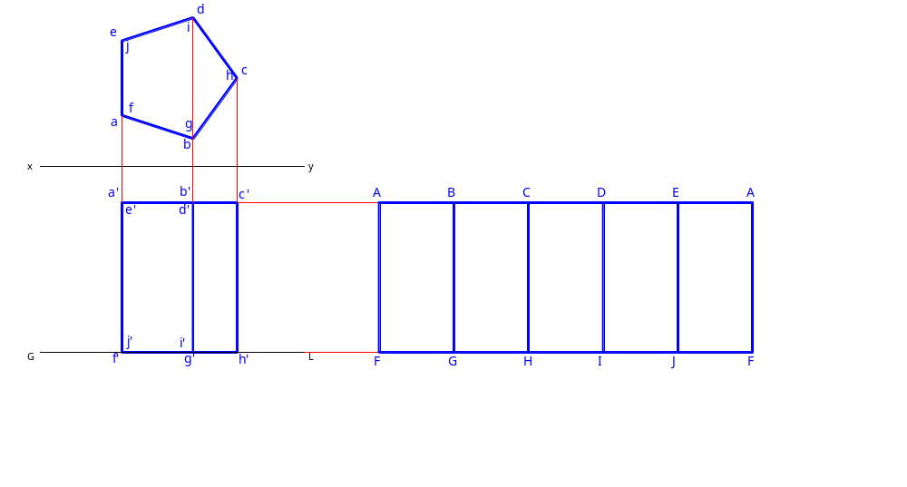
Example 1:
A pentagonal prism of 25 mm each side of base, and 50 mm height rest on the ground on one of its bases. One rectangular face is perpendicular to the V.P. Draw its development.

Slide 15
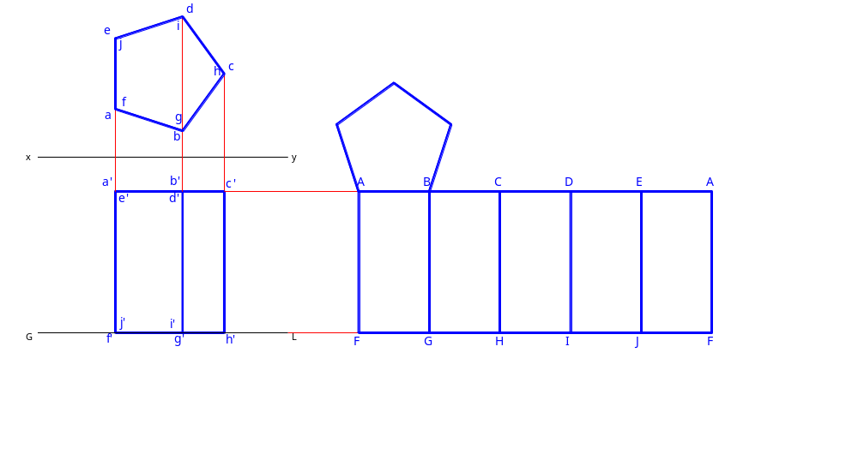
Example 1:
A pentagonal prism of 25 mm each side of base, and 50 mm height rest on the ground on one of its bases. One rectangular face is perpendicular to the V.P. Draw its development.

Slide 16

Example 1:
A pentagonal prism of 25 mm each side of base, and 50 mm height rest on the ground on one of its bases. One rectangular face is perpendicular to the V.P. Draw its development.

Slide 17
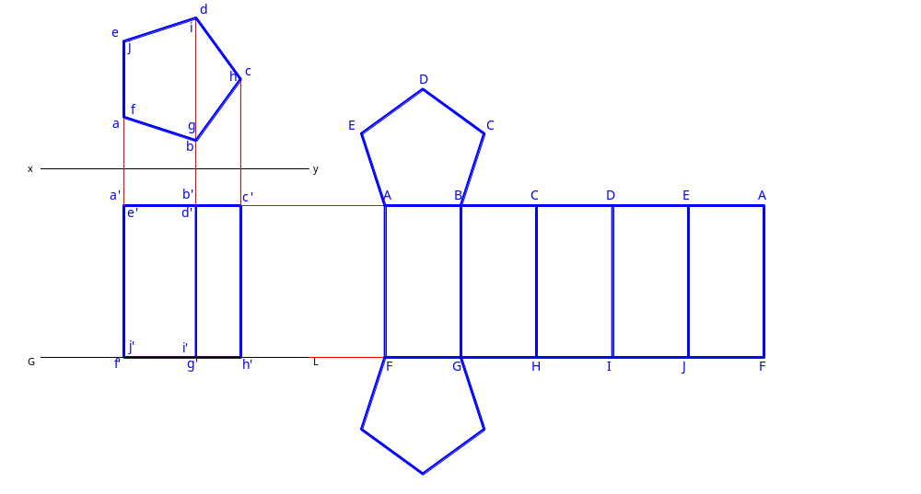
Example 1:
A pentagonal prism of 25 mm each side of base, and 50 mm height rest on the ground on one of its bases. One rectangular face is perpendicular to the V.P. Draw its development.

Slide 18

Example 1:
A pentagonal prism of 25 mm each side of base, and 50 mm height rest on the ground on one of its bases. One rectangular face is perpendicular to the V.P. Draw its development.

Slide 19
DEVELOPMENT OF A TRUNCATED PRISM

Slide 20
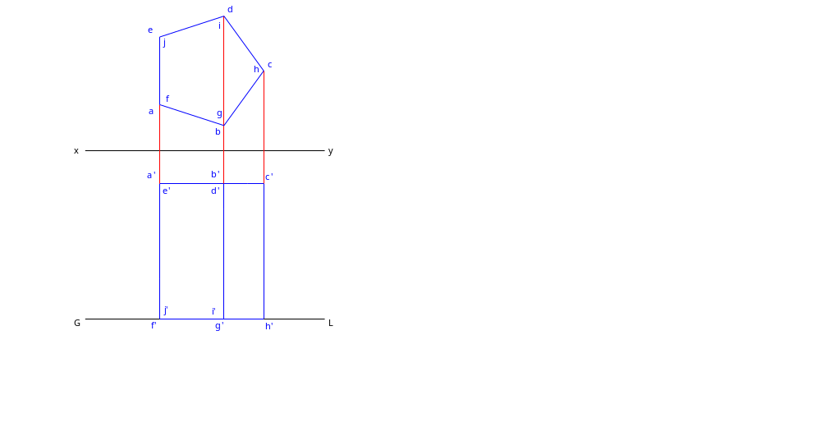
DEVELOPMENT OF A TRUNCATED PRISM

Slide 21
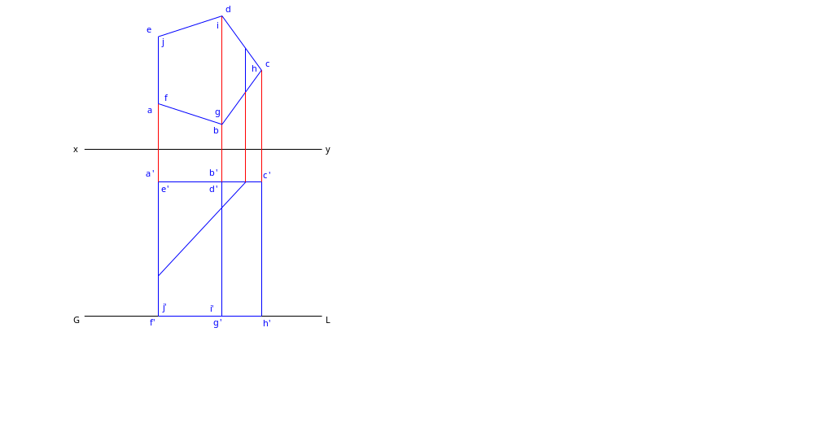
DEVELOPMENT OF A TRUNCATED PRISM

Slide 22
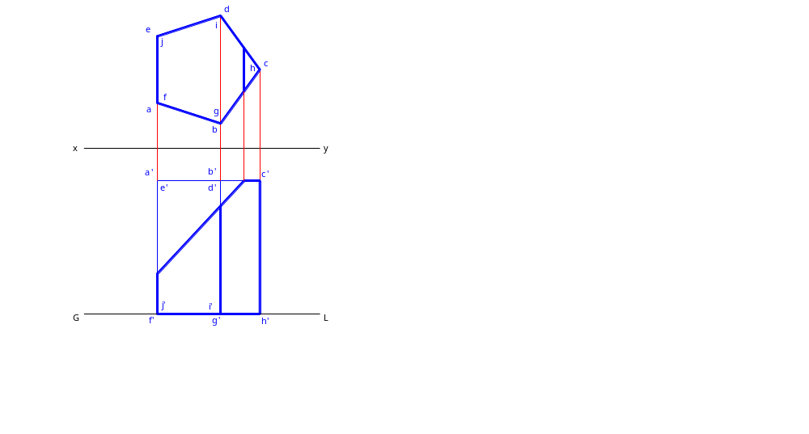
DEVELOPMENT OF A TRUNCATED PRISM

Slide 23

DEVELOPMENT OF A TRUNCATED PRISM

Slide 24
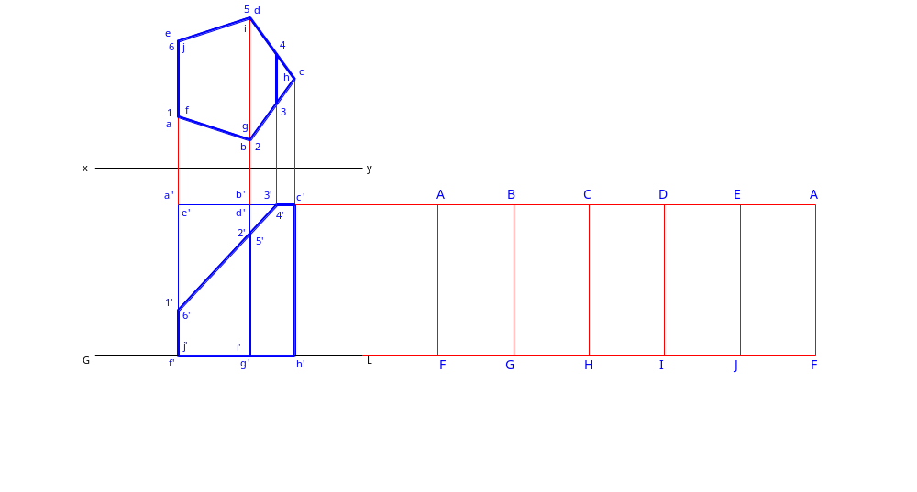
DEVELOPMENT OF A TRUNCATED PRISM

Slide 25
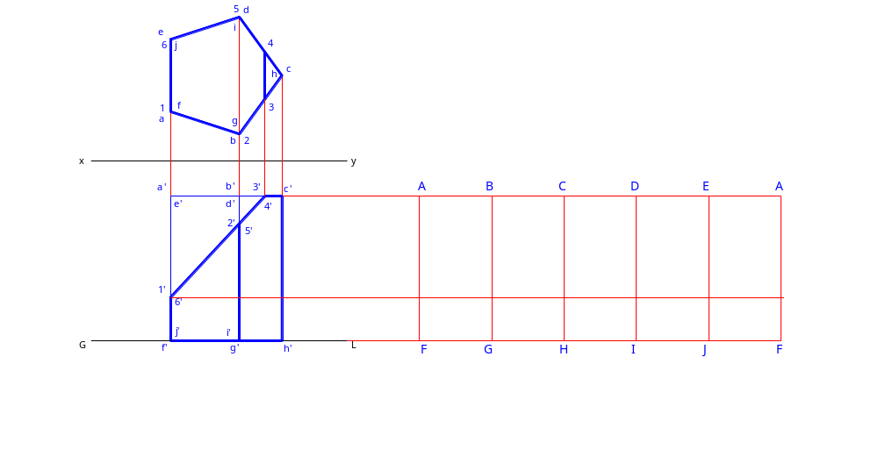
DEVELOPMENT OF A TRUNCATED PRISM

Slide 26

DEVELOPMENT OF A TRUNCATED PRISM

Slide 27
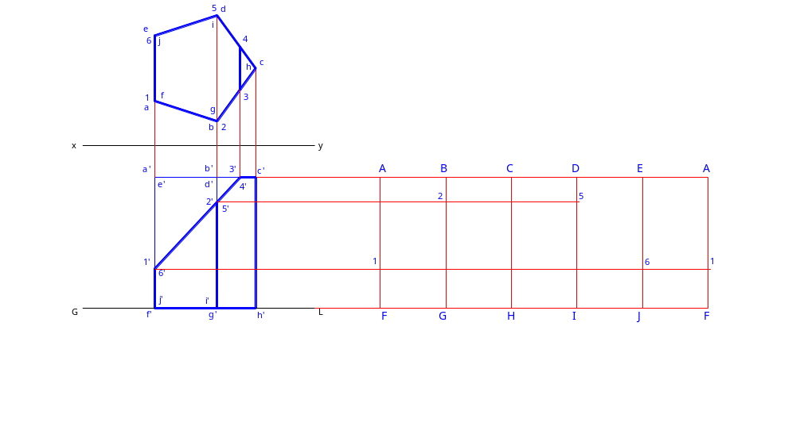
DEVELOPMENT OF A TRUNCATED PRISM

Slide 28

DEVELOPMENT OF A TRUNCATED PRISM

Slide 29

DEVELOPMENT OF A TRUNCATED PRISM

Slide 30
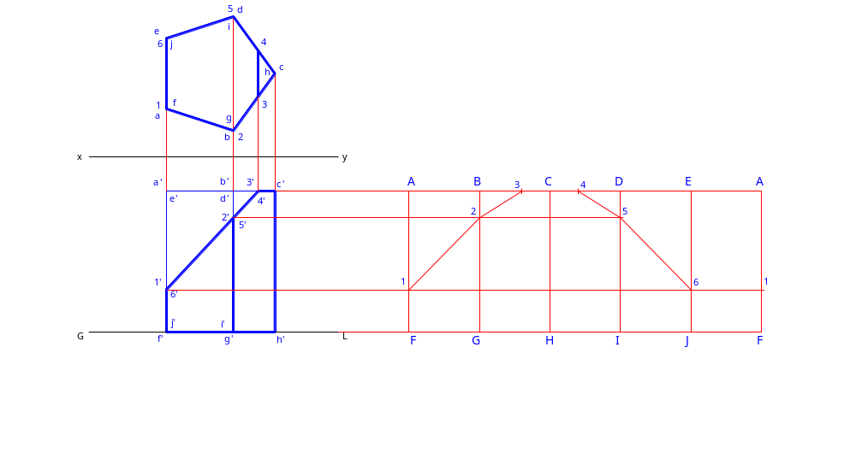
DEVELOPMENT OF A TRUNCATED PRISM

Slide 31
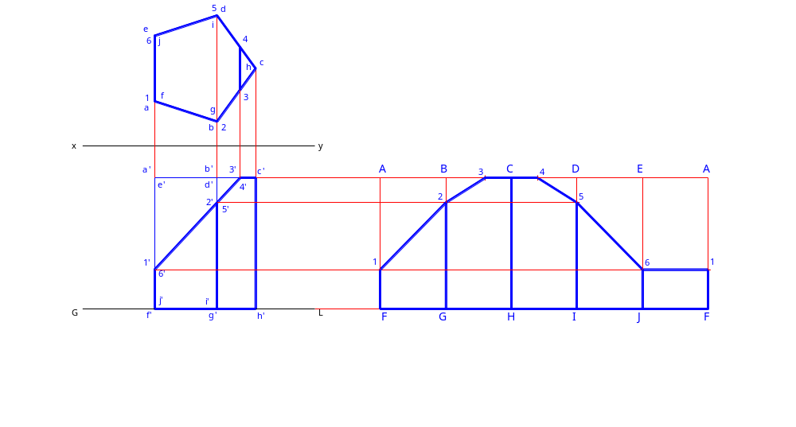
DEVELOPMENT OF A TRUNCATED PRISM

Slide 32
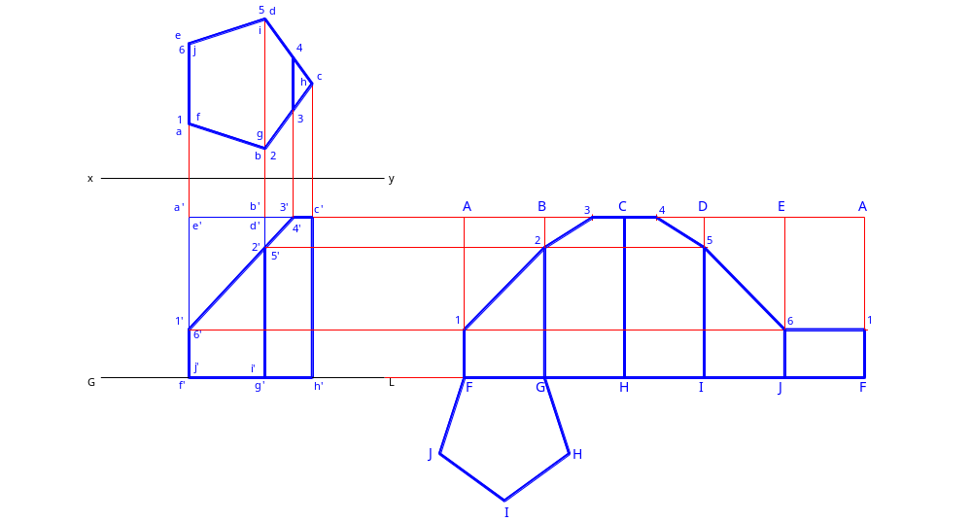
DEVELOPMENT OF A TRUNCATED PRISM

Slide 33
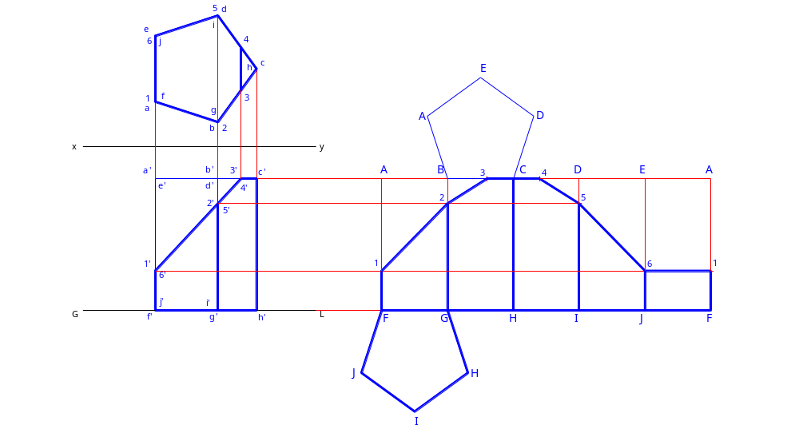
DEVELOPMENT OF A TRUNCATED PRISM

Slide 34
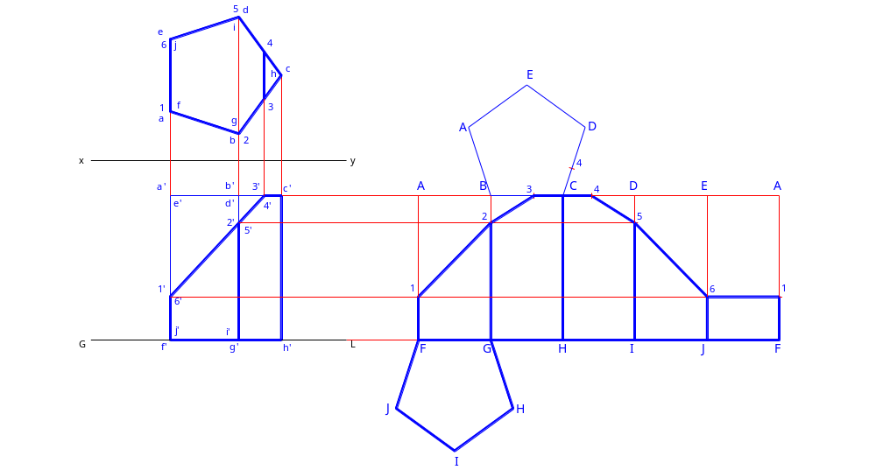
DEVELOPMENT OF A TRUNCATED PRISM

Slide 35
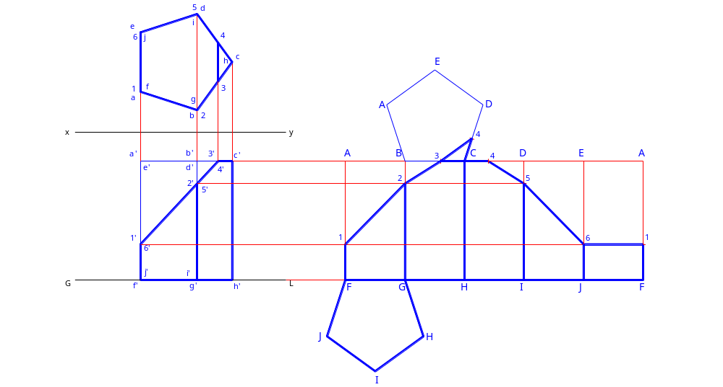
DEVELOPMENT OF A TRUNCATED PRISM

Slide 36
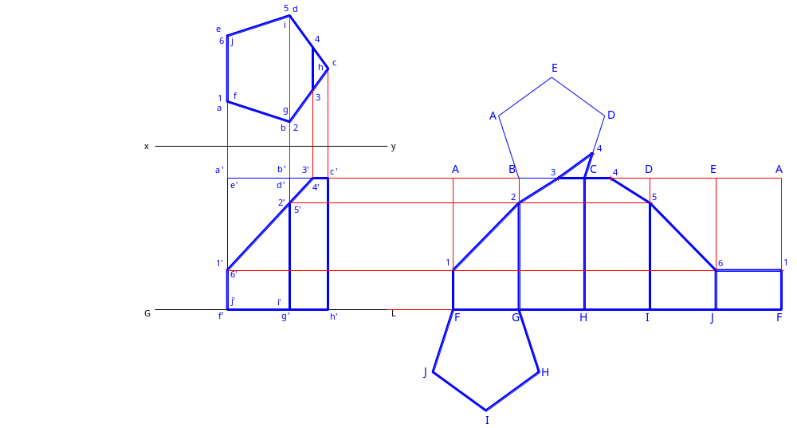
DEVELOPMENT OF A TRUNCATED PRISM

Slide 37
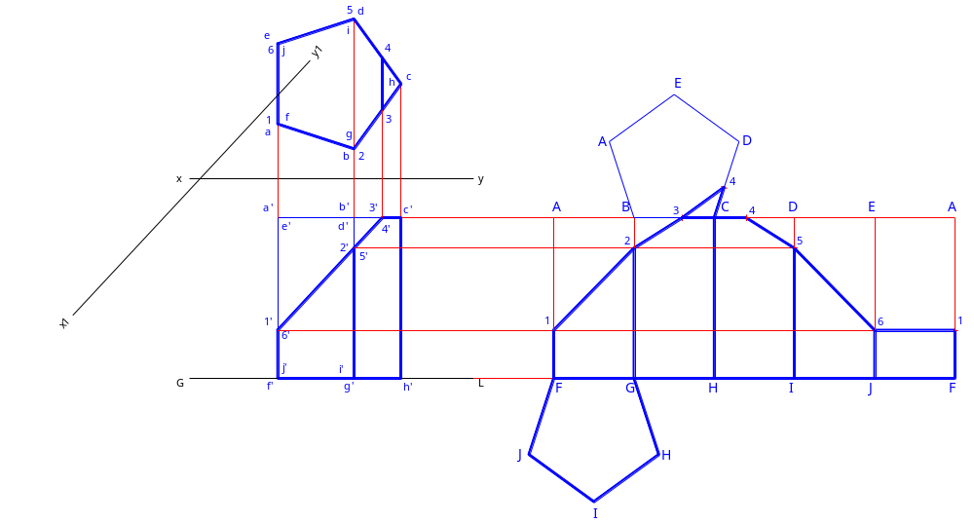
DEVELOPMENT OF A TRUNCATED PRISM

Slide 38
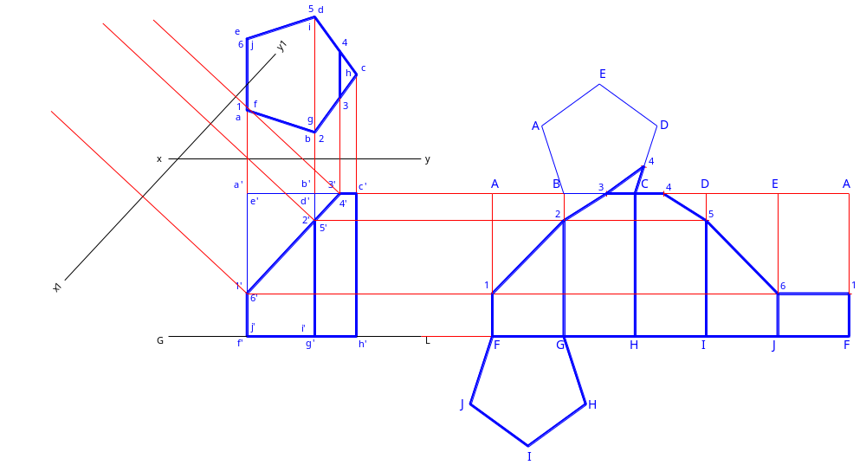
DEVELOPMENT OF A TRUNCATED PRISM

Slide 39

DEVELOPMENT OF A TRUNCATED PRISM

Slide 40

DEVELOPMENT OF A TRUNCATED PRISM

Slide 41
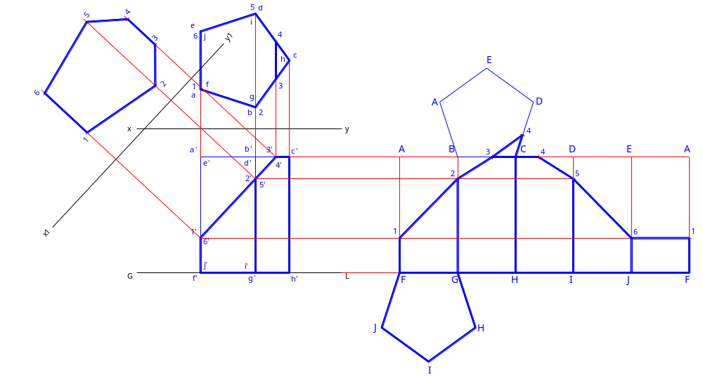
DEVELOPMENT OF A TRUNCATED PRISM

Slide 42
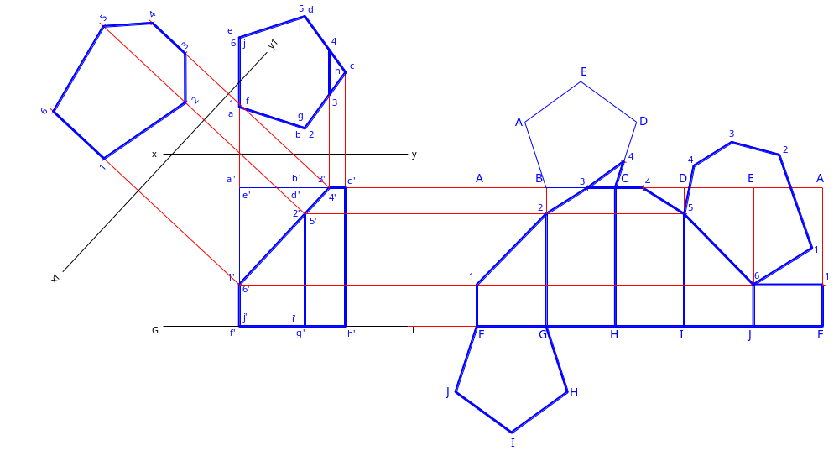
DEVELOPMENT OF A TRUNCATED PRISM

Slide 43
DEVELOPMENT OF A CYLINDER
  The developed surface will have a shape of a rectangle having the length equal to the circumference of the base circle and the height equal to the height of the cylinder.
  The bending lines on the developed surface must not be highlighted.
  Any line on the cylinder whether appearing straight or curved, must be drawn curved on the developed surface.

Slide 44
DEVELOPMENT OF A FULL PYRAMID
  The developed surface will be triangles connected side by side and sharing a common apex.
  The folding lines on the developed surface must be shown and highlighted.

Slide 45
Example 2:
A square pyramid of 30 mm each side of base, and 45 mm height rest on the ground on one of its bases. One rectangular side of the base is inclined at 15º to the V.P. Draw its development.

Slide 46
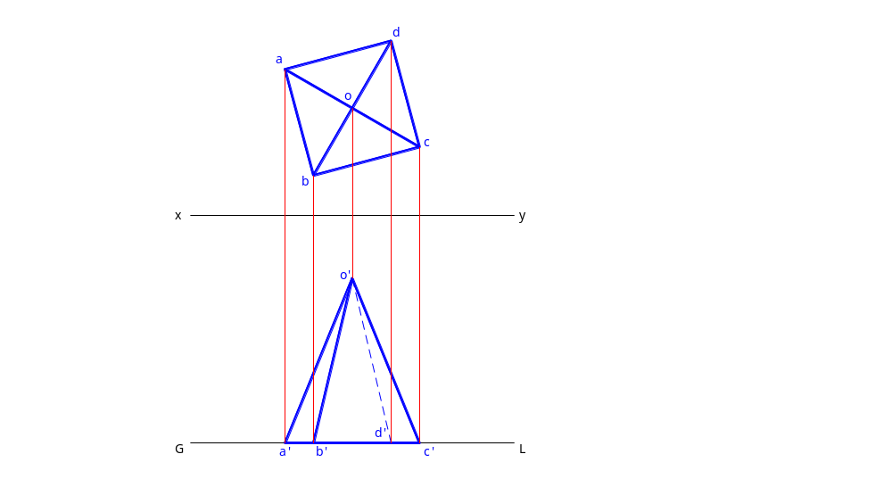
Example 2:
A square pyramid of 30 mm each side of base, and 45 mm height rest on the ground on one of its bases. One rectangular side of the base is inclined at 15º to the V.P. Draw its development.

Slide 47
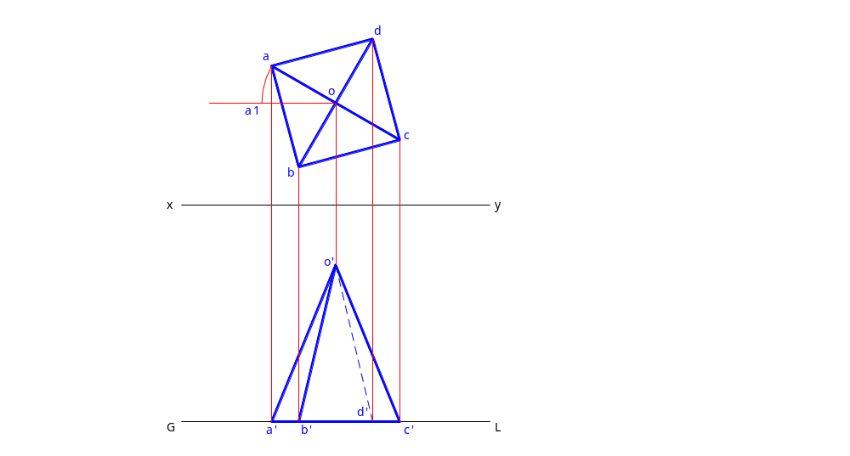
Example 2:
A square pyramid of 30 mm each side of base, and 45 mm height rest on the ground on one of its bases. One rectangular side of the base is inclined at 15º to the V.P. Draw its development.

Slide 48
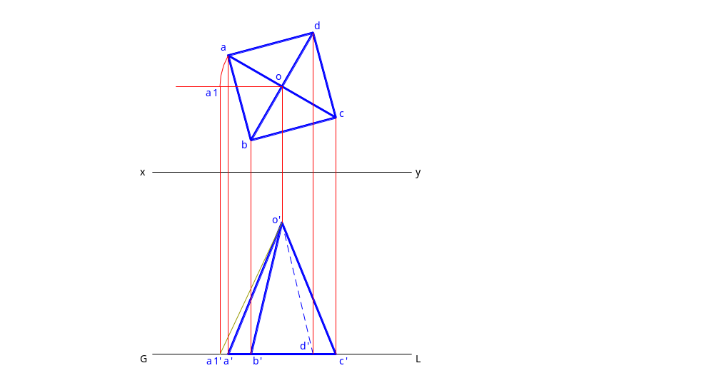
Example 2:
A square pyramid of 30 mm each side of base, and 45 mm height rest on the ground on one of its bases. One rectangular side of the base is inclined at 15º to the V.P. Draw its development.

Slide 49
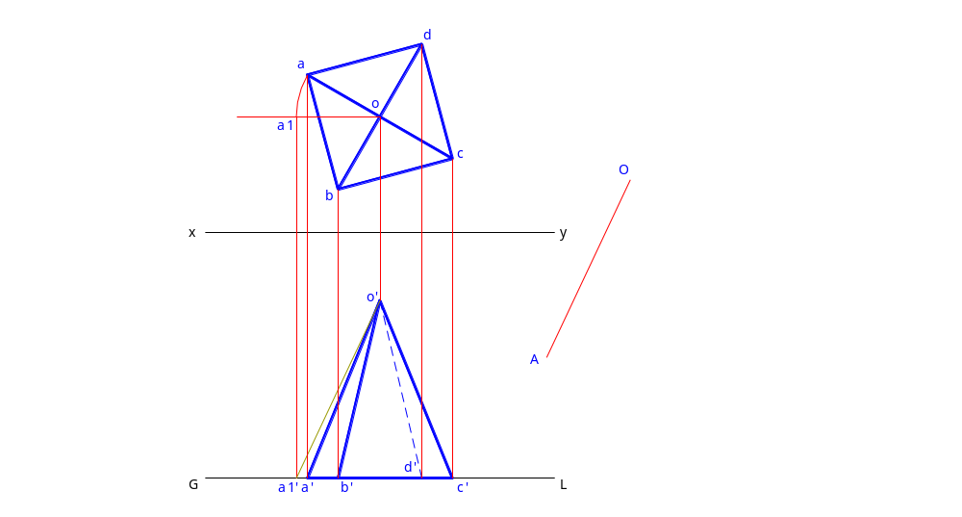
Example 2:
A square pyramid of 30 mm each side of base, and 45 mm height rest on the ground on one of its bases. One rectangular side of the base is inclined at 15º to the V.P. Draw its development.

Slide 50
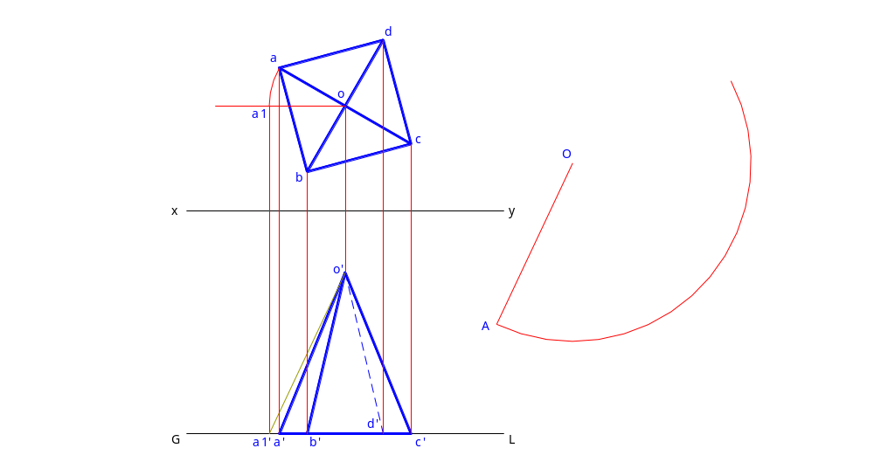
Example 2:
A square pyramid of 30 mm each side of base, and 45 mm height rest on the ground on one of its bases. One rectangular side of the base is inclined at 15º to the V.P. Draw its development.

Slide 51

Example 2:
A square pyramid of 30 mm each side of base, and 45 mm height rest on the ground on one of its bases. One rectangular side of the base is inclined at 15º to the V.P. Draw its development.

Slide 52
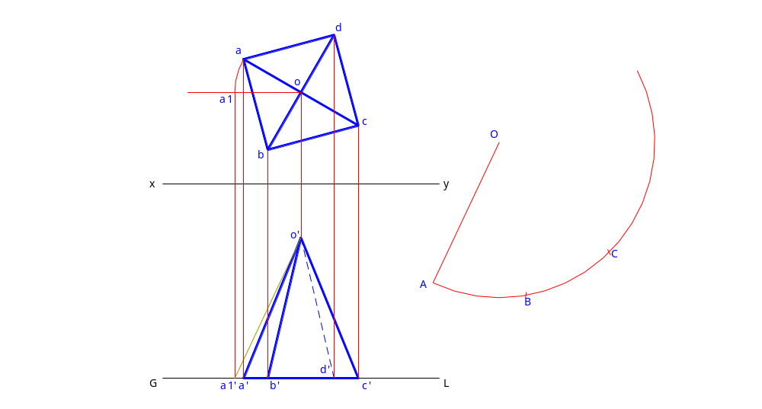
Example 2:
A square pyramid of 30 mm each side of base, and 45 mm height rest on the ground on one of its bases. One rectangular side of the base is inclined at 15º to the V.P. Draw its development.

Slide 53

Example 2:
A square pyramid of 30 mm each side of base, and 45 mm height rest on the ground on one of its bases. One rectangular side of the base is inclined at 15º to the V.P. Draw its development.

Slide 54
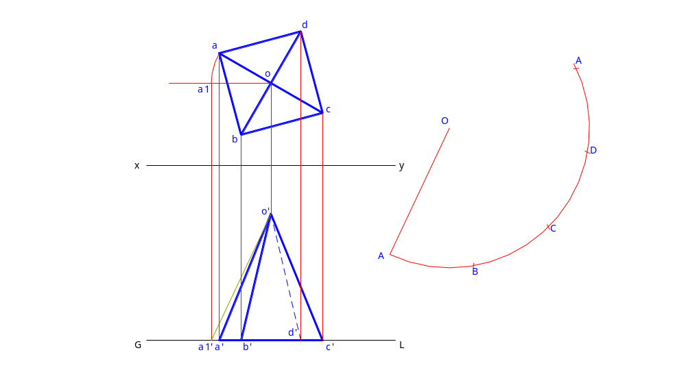
Example 2:
A square pyramid of 30 mm each side of base, and 45 mm height rest on the ground on one of its bases. One rectangular side of the base is inclined at 15º to the V.P. Draw its development.

Slide 55
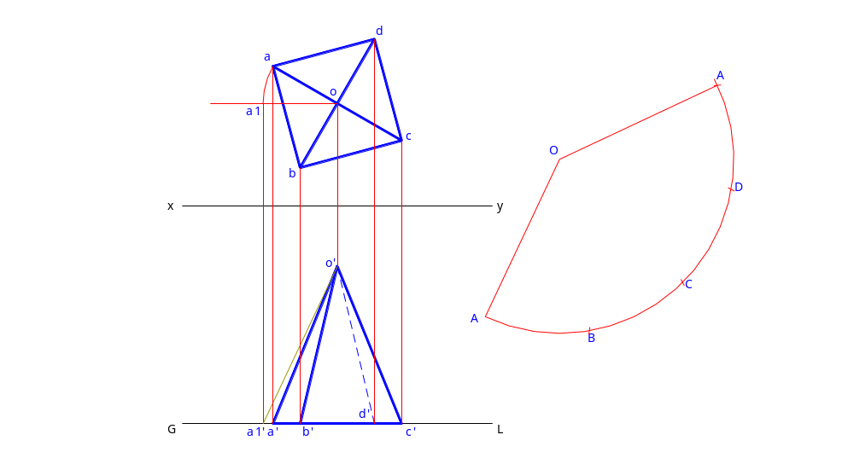
Example 2:
A square pyramid of 30 mm each side of base, and 45 mm height rest on the ground on one of its bases. One rectangular side of the base is inclined at 15º to the V.P. Draw its development.

Slide 56
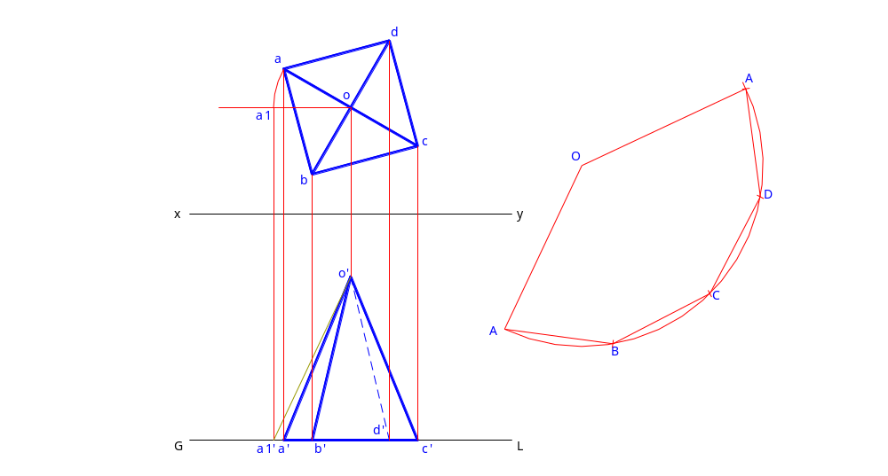
Example 2:
A square pyramid of 30 mm each side of base, and 45 mm height rest on the ground on one of its bases. One rectangular side of the base is inclined at 15º to the V.P. Draw its development.

Slide 57
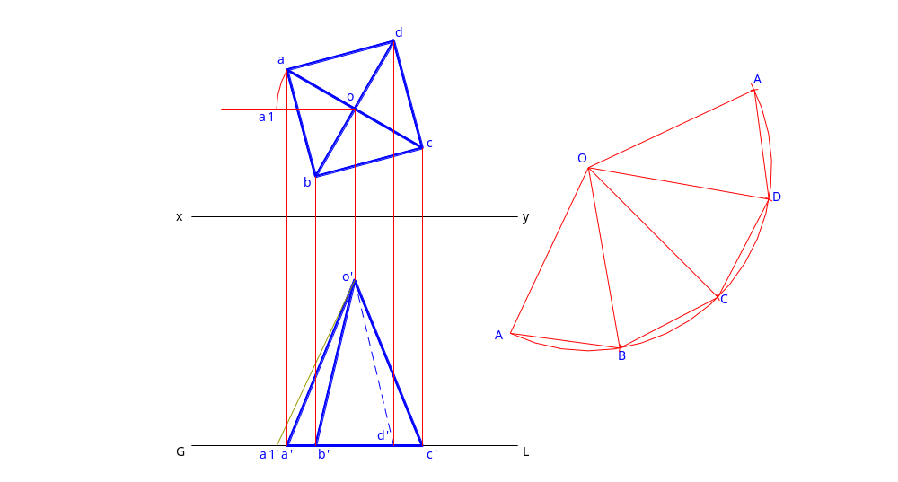
Example 2:
A square pyramid of 30 mm each side of base, and 45 mm height rest on the ground on one of its bases. One rectangular side of the base is inclined at 15º to the V.P. Draw its development.

Slide 58
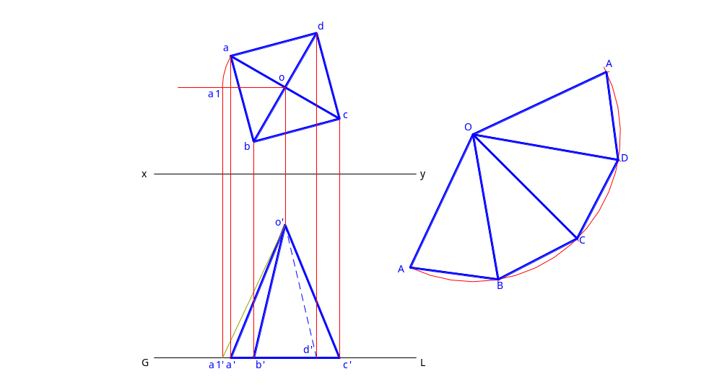
Example 2:
A square pyramid of 30 mm each side of base, and 45 mm height rest on the ground on one of its bases. One rectangular side of the base is inclined at 15º to the V.P. Draw its development.

Slide 59
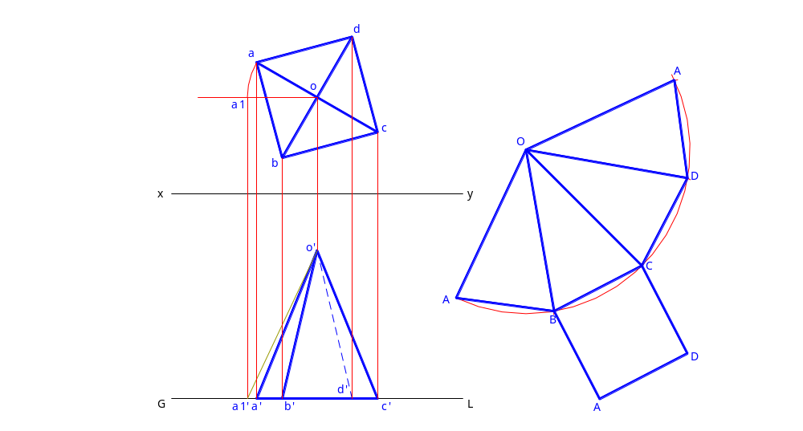
Example 2:
A square pyramid of 30 mm each side of base, and 45 mm height rest on the ground on one of its bases. One rectangular side of the base is inclined at 15º to the V.P. Draw its development.

Slide 60
6. DEVELOPMENT OF A CONE
  The developed surface will be a sector of a circle with radius equal to the generator of the cone and the arc length being equal to the circumference of the base of cone.
  The bending lines on the developed surface must not be highlighted.
  Any line on the cone whether appearing straight or curved, must be drawn curved on the developed surface.

Slide 61
7. DEVELOPMENT OF A SPHERE
  Only approximate methods are available as the surface is double curved.
      Zone method
      Lune method

Slide 62
8. DEVELOPMENT OF TRANSITION PIECES
  Transition pieces are used to connect pipes or openings of different shapes of cross section.
  Always developed by the method of triangulation.

Slide 63
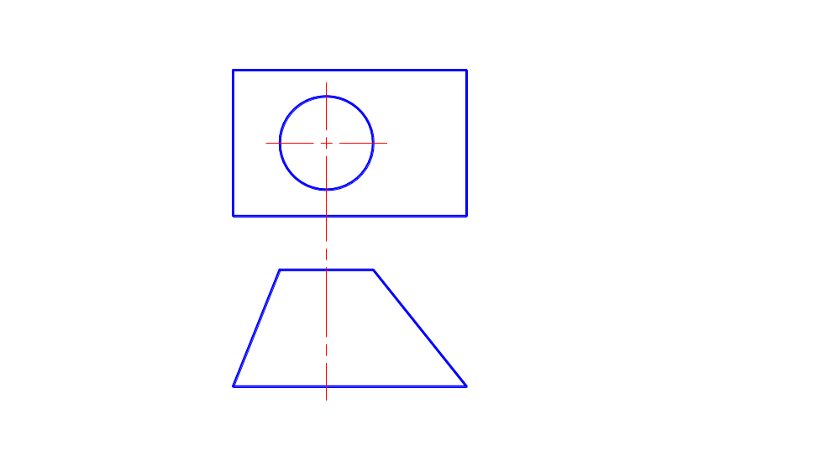

Slide 64
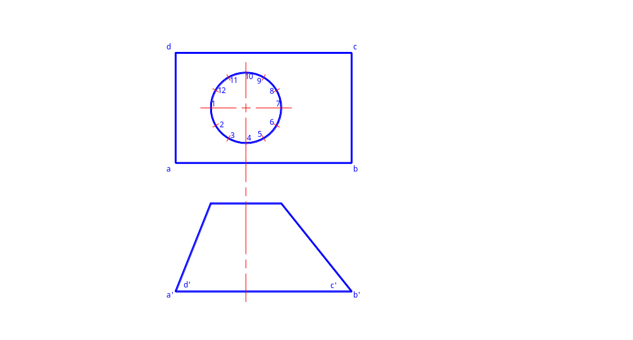

Slide 65
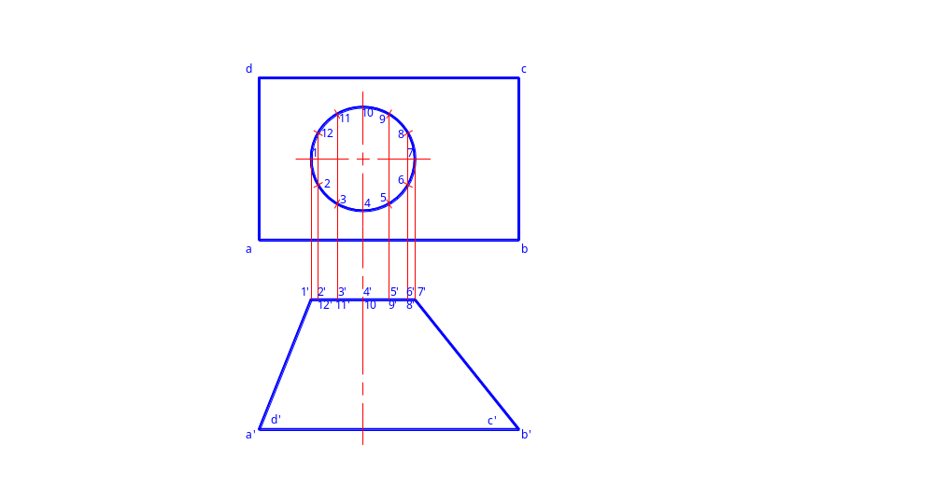

Slide 66
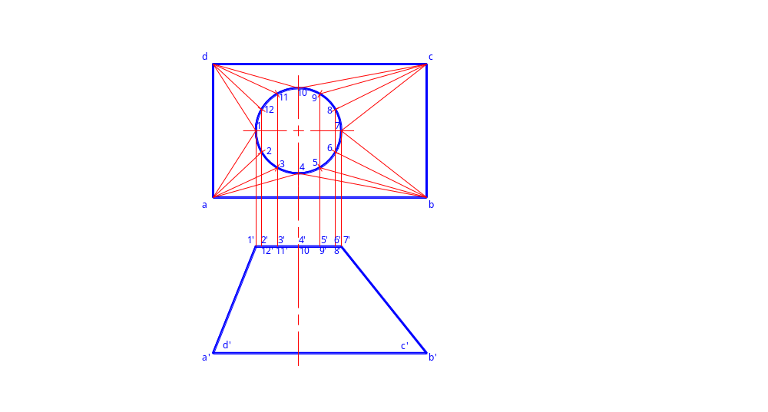

Slide 67
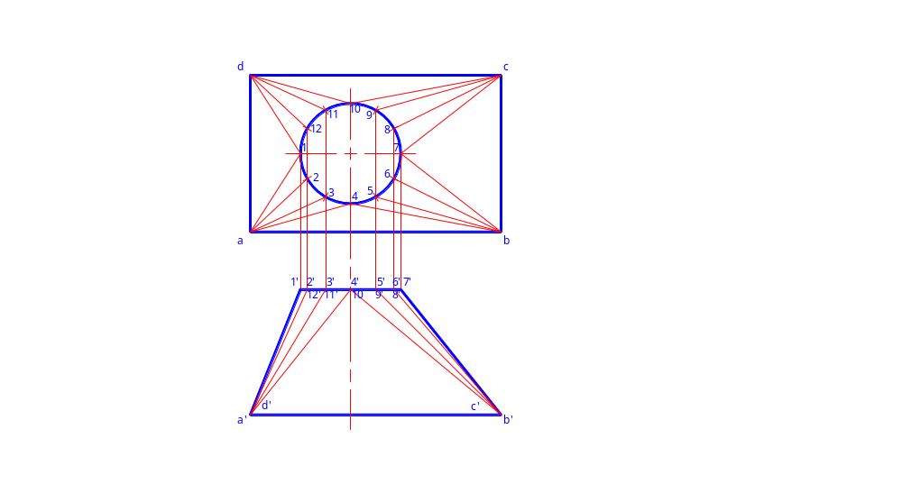

Slide 68
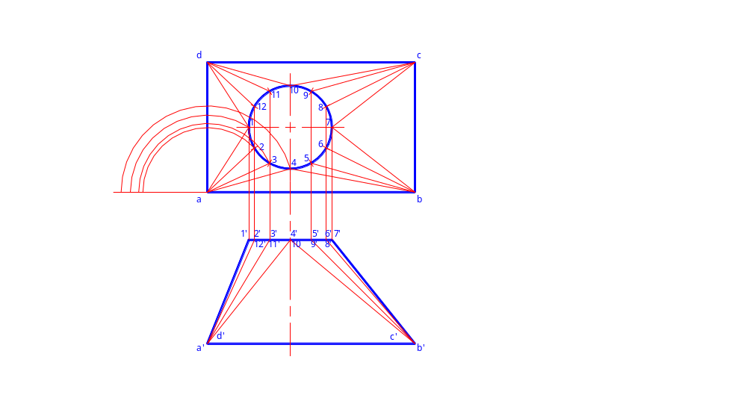

Slide 69
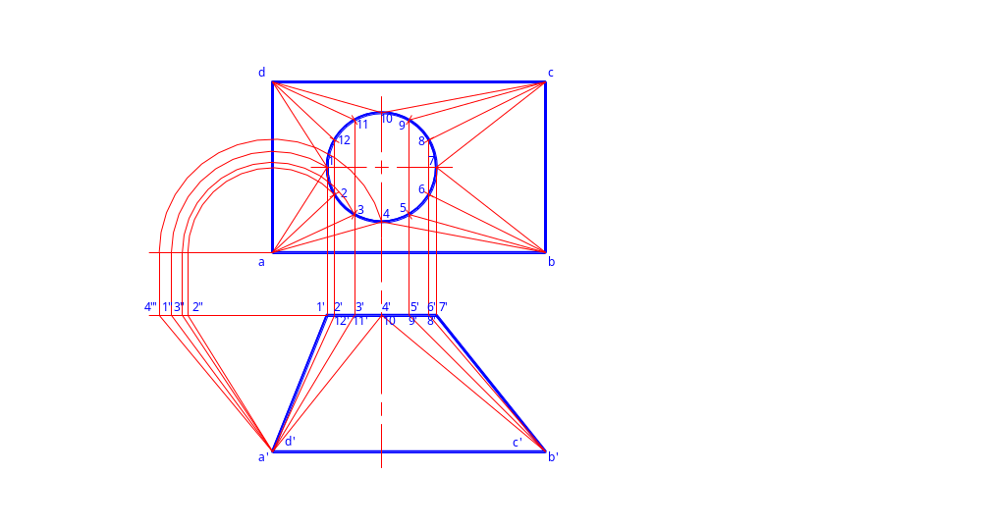

Slide 70
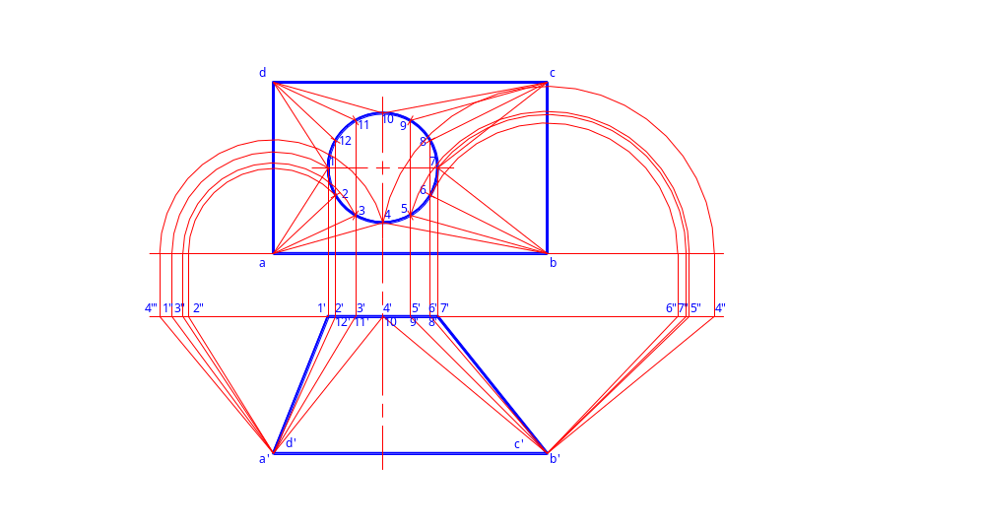

Slide 71
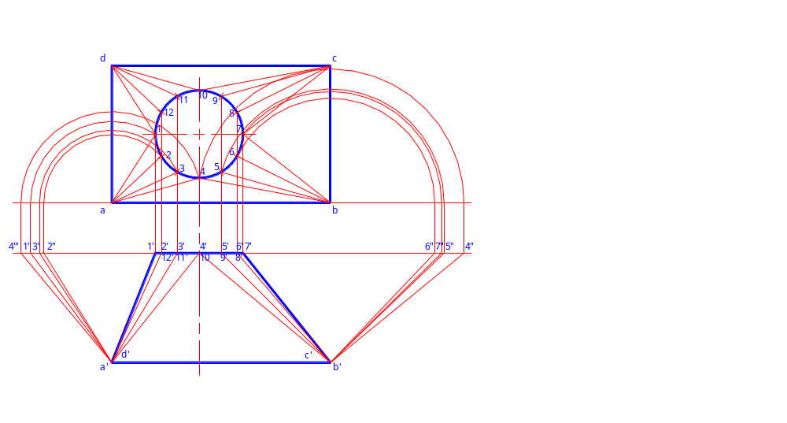

Slide 72
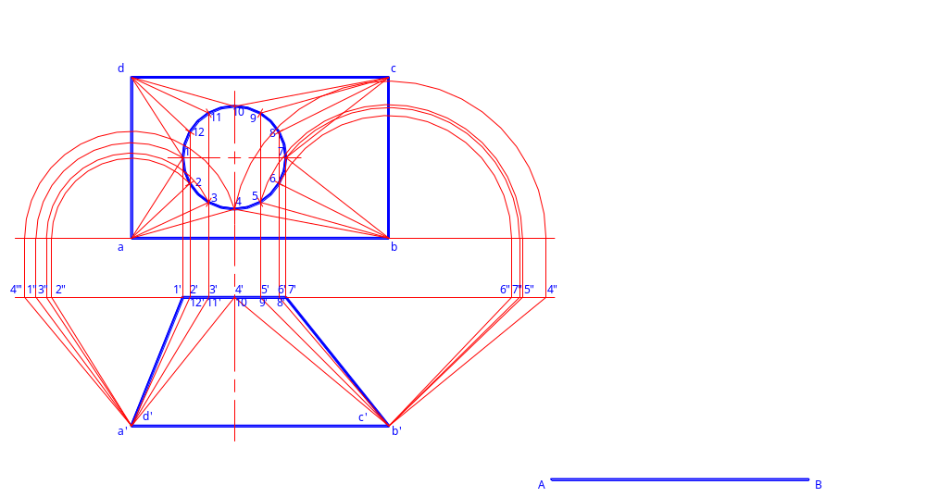

Slide 73


Slide 74
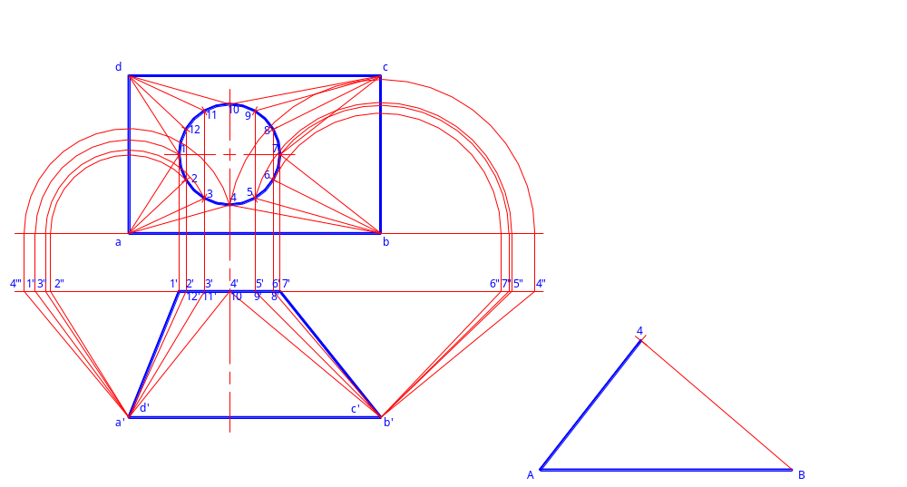

Slide 75
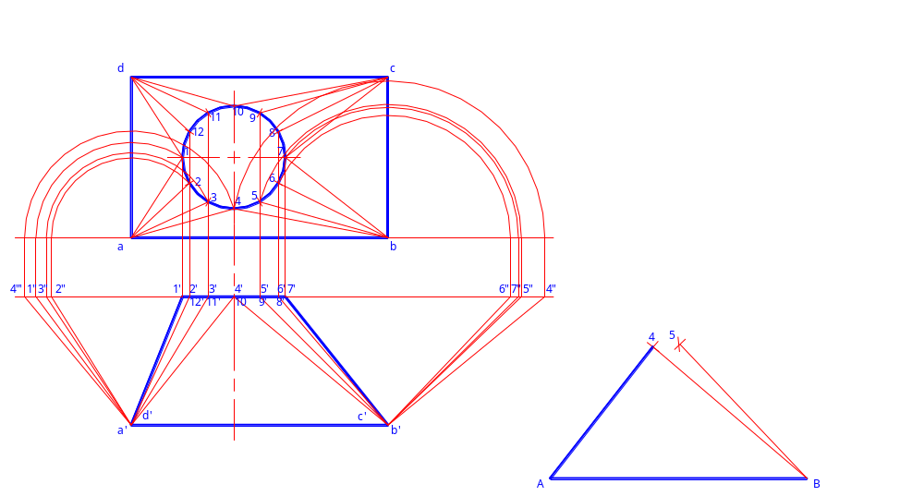

Slide 76


Slide 77


Slide 78


Slide 79


Slide 80


Slide 81


Slide 82


Slide 83


Slide 84


Slide 85


Slide 86


Slide 87


Slide 88


Slide 89


Slide 90


Slide 91


Slide 92


Slide 93


Slide 94
Thank You

Slide 95
Quizzes and Assign. Session
Quiz 1:
    A regular pentagon of 25mm side has one side on the ground. Its plane is inclined at 45 to the H.P and perpendicular to the V.P. draw its projections
Quiz 2:
    A hexagonal prism, base 40 mm side and height 40mm has a hole of 40 mm diameter drilled centrally through its ends. Draw its projections when its is resting on one of its corner on the H.P. with its axis inclined at 60 to the H.P and two of its faces parallel to the V.P.
Assign 1:
    Draw the projections of a regular pentagon of 40 mm side, having its surface inclined at 30 to H.P. and a side Parallel to the H.P. and inclined at an angle of 60 to the V.P.
Assign 2:
    A pentagonal prism is resting on a corner of its base on the ground with a longer edge containing that corner inclined at 45 to the H.P. and the vertical plane containing that edge and the axis inclined at 30 to the V.P. Draw its projections. Base 40 mm side; height 65mm.

Slide 96
Quizzes and Assign. Session…1
Quiz 1:
    Draw the projections of a circle of 50mm diameter, having its plane vertical and inclined at 30 to the V.P. its center is 30mm above the H.P. and 20 mm in front of the V.P.
Quiz 2:
    A hexagonal prism, base 40 mm side and height 40mm has a hole of 40 mm diameter drilled centrally through its ends. Draw its projections when its is resting on one of its corner on the H.P. with its axis inclined at 60 to the H.P and two of its faces parallel to the V.P.
Assign 1:
    Draw the projections of a rhombus having diagonals 125 mm and 50 mm long, the smaller diagonal of which is parallel to both the principals planes, while the other is inclined at 30 to the H.P.
Assign 2:
    A pentagonal prism is resting on a corner of its base on the ground with a longer edge containing that corner inclined at 45 to the H.P. and the vertical plane containing that edge and the axis inclined at 30 to the V.P. Draw its projections. Base 40 mm side; height 65mm.

